Slide 1
DeepEvent-VO: Fusing Intensity and Event-Based Frames for End-to-End
Deep Visual Odometry
Abhay Gupta (abhayg), Ganesh Iyer (giyer), Suhit Kodgule (skodgule)

Slide 2
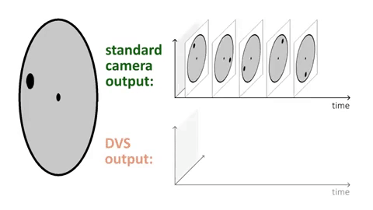
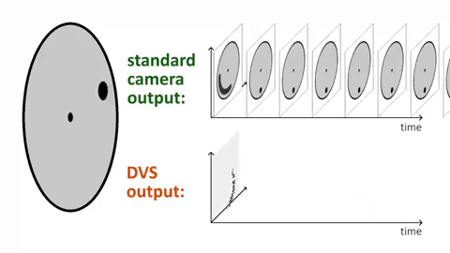
What are Event-based Cameras?

Slide 3
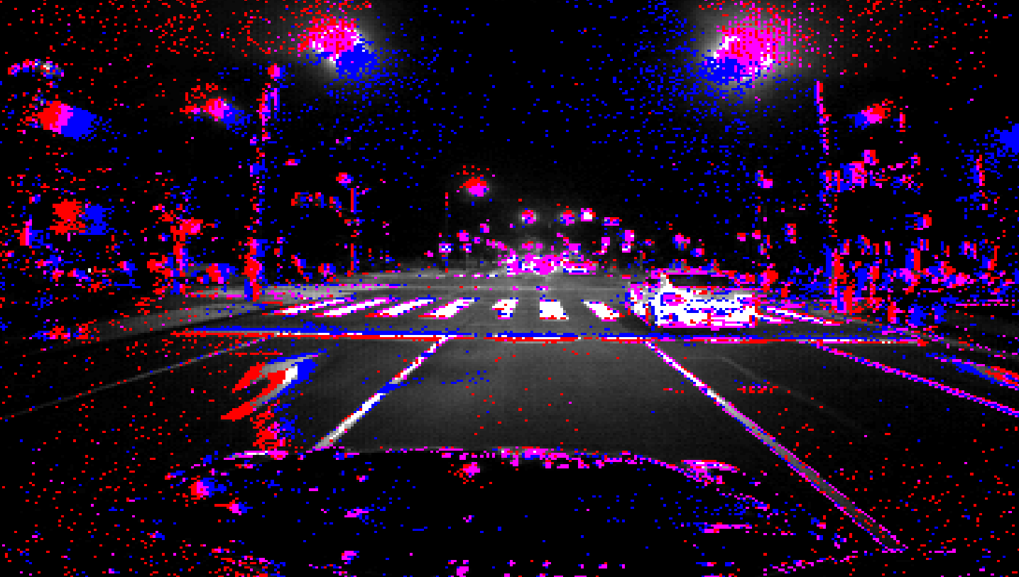
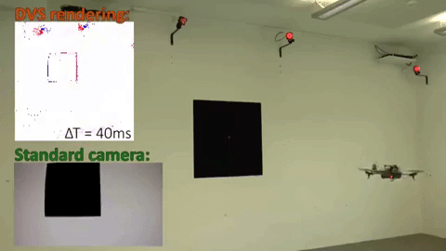
Night Time Driving
High-speed scenarios

Slide 4

Event-based Time Surfaces
Event e = {x,t,p}
where,
x = pixel location (u,v)
t = timestamp
P = polarity

Slide 5
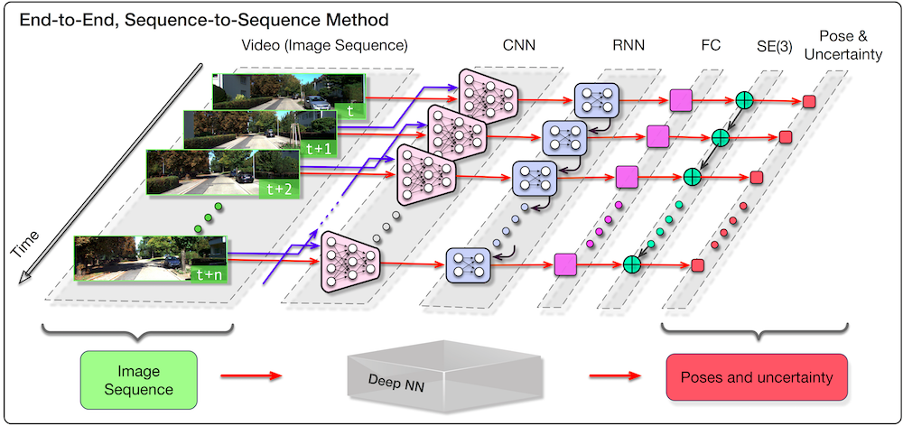
Deep Learning Methods for End-to-End Visual Odometry and Egomotion Prediction
DeepVO: Towards VO with Deep Learning (Supervised)

Slide 6
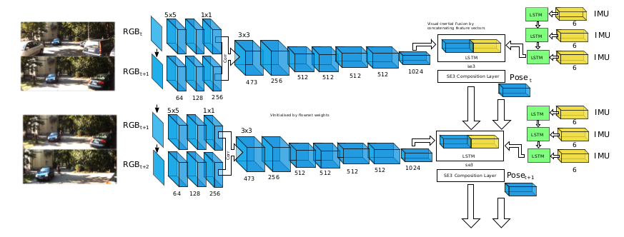
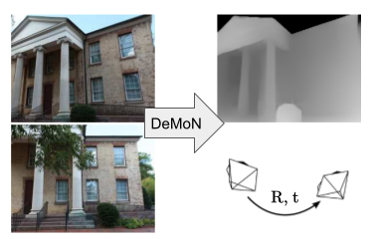
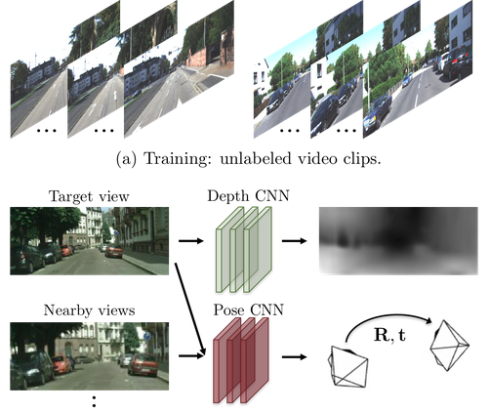
Visual-Inertial Net
Depth as a supervisory signal

Slide 7
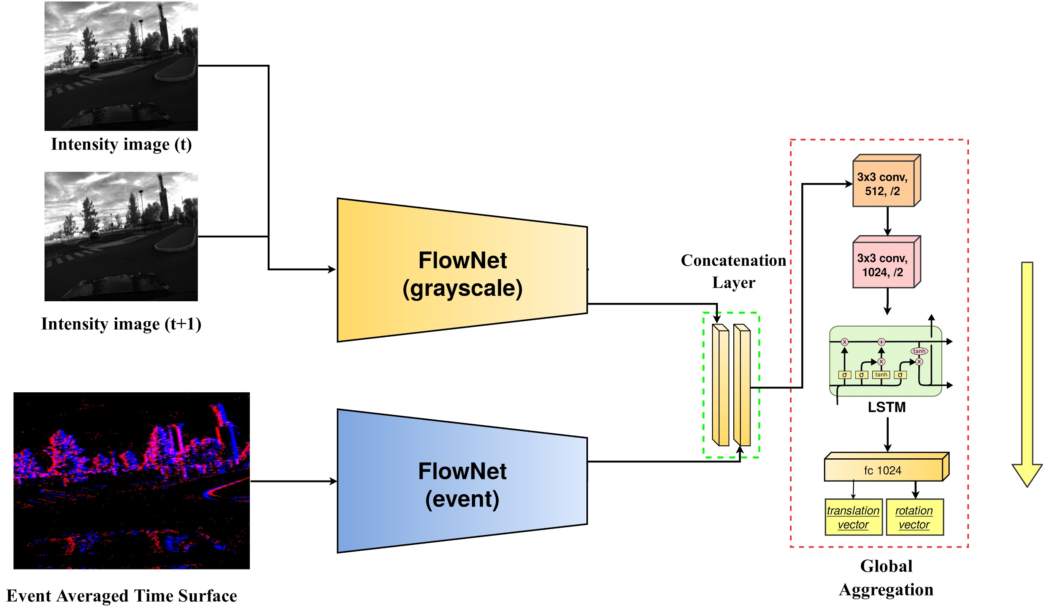
Fusing Intensity and Event Streams
Incorporating the best of both worlds, reliably!
Time

Slide 8
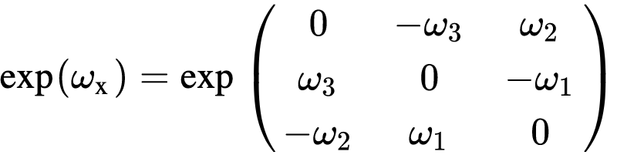
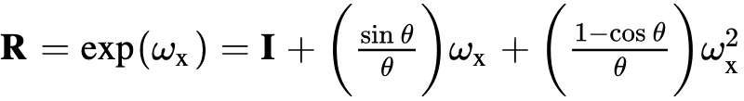
Exponential Maps [SO(3)]
The network predicts (⍵,t) [se(3)] parameters:

Slide 9
Training Details
Multi-Vehicle Stereo Event Camera Dataset
Training images : 3400 frames
Test sequence : 1100 frames
Data Collection was hard: Synchronizing Events, Intensity and Pose timestamped frames using ROS

Slide 10
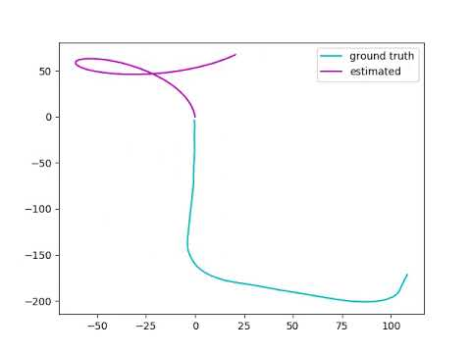
DeepVO Trajectory Results

Slide 11
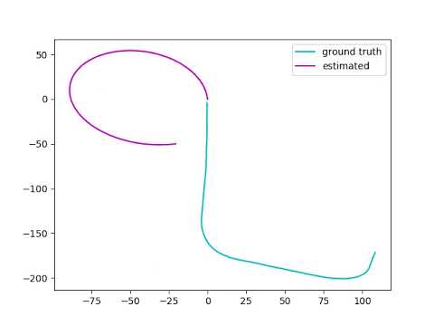
DeepEvent-VO Trajectory Results

Slide 12
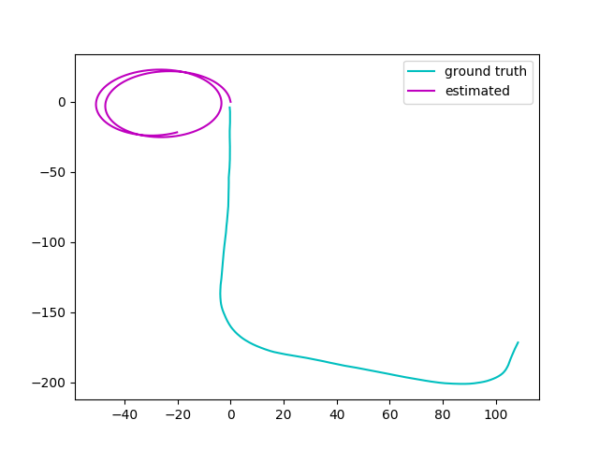
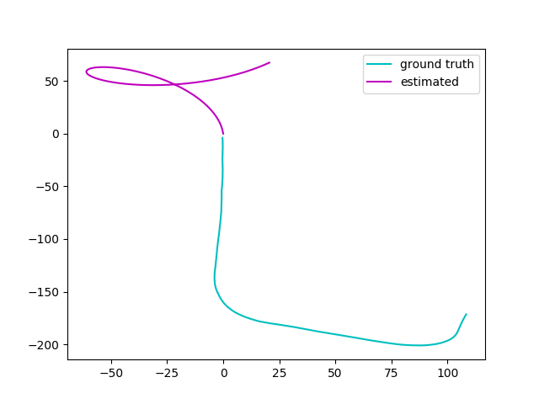
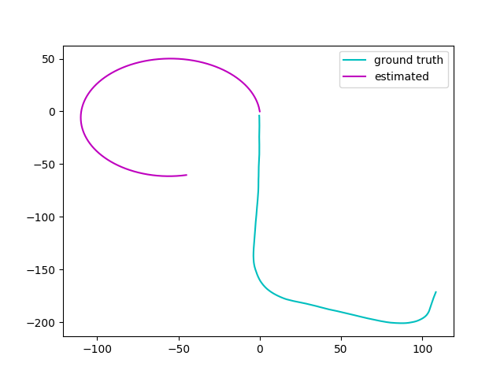
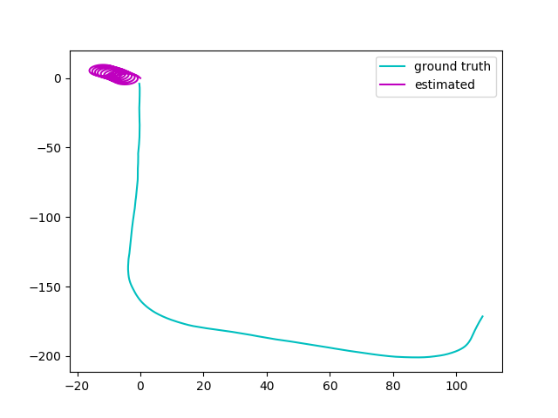
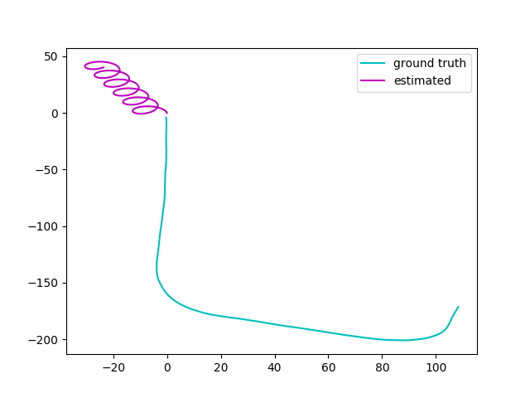
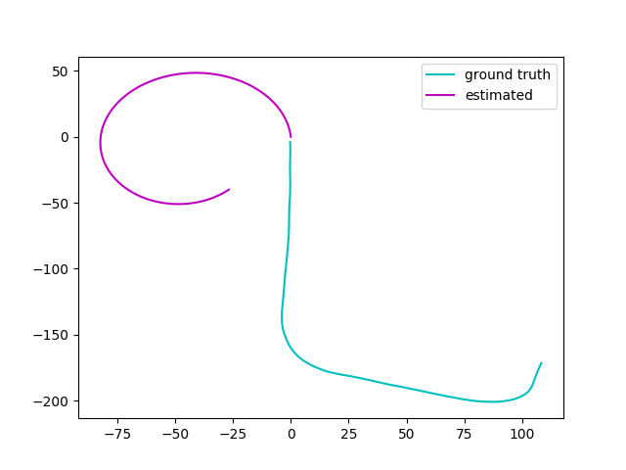
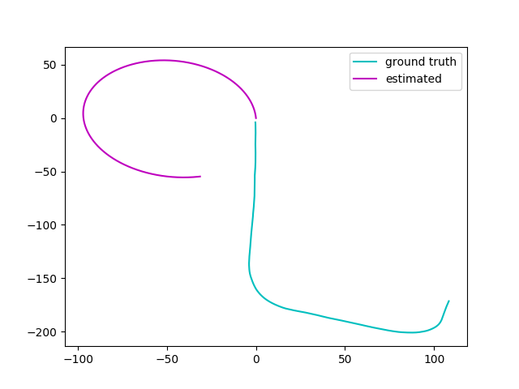
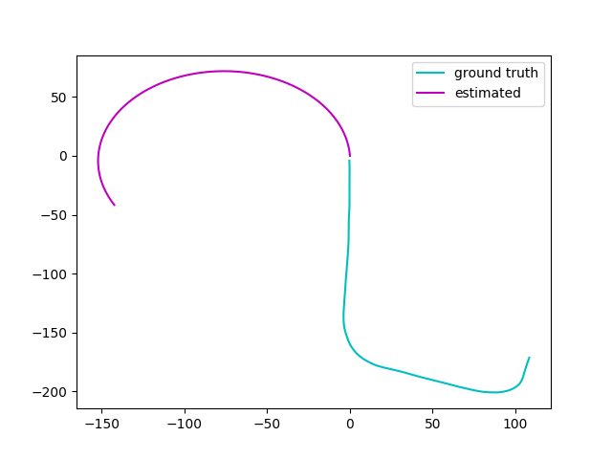
Comparison by Time Steps
Deep VO
t =0
t =20
t =40
t =60
Deep-Event VO
t =0
t =20
t =40
t =60

Slide 13
Future Work
Training with more data, making it generalizable
A (possibly) better representation
Incorporating Bundle Adjustment or an equivalent backend
Code available at Github

Slide 14
References
Wang, Sen, et al. "Deepvo: Towards end-to-end visual odometry with deep recurrent convolutional neural networks." 2017 IEEE International Conference on Robotics and Automation (ICRA). IEEE, 2017.
Clark, Ronald, et al. "Vinet: Visual-inertial odometry as a sequence-to-sequence learning problem." Thirty-First AAAI Conference on Artificial Intelligence. 2017.
Zhou, Tinghui, et al. "Unsupervised learning of depth and ego-motion from video." Proceedings of the IEEE Conference on Computer Vision and Pattern Recognition. 2017.
Zhu, Alex Zihao, et al. "The multivehicle stereo event camera dataset: An event camera dataset for 3D perception." IEEE Robotics and Automation Letters 3.3 (2018): 2032-2039.
Visualization of Event Streams from Mueggler et. al, University of Zurich

Slide 15
Q & A

